Slide 1

SOAP NOTE
GENERATOR
Presented By
Mukta Naik 612203122
Sujal Nandapurkar 612203123
Revati Patare 612203131
Tanuja Patil 612203138

Slide 2
PROBLEM STATEMENT
Generating structured SOAP notes from medical conversations is a challenging NLP task due to unstructured dialogue, multiple speakers and contextual medical information. Most existing clinical NLP systems focus on English datasets, with limited support for Indic languages such as Marathi and Hindi. This project develops an automated pipeline that performs speech-to-text conversion, extracts clinical entities from conversations, and generates SOAP notes in Indic languages.
The system aims to:
Process medical dialogue transcripts in indic languages
Perform clinical entity extraction and contextual understanding
Classify relevant information into Subjective, Objective, Assessment and Plan sections
Generate structured SOAP notes that can assist in automated clinical documentation within healthcare systems

Slide 3
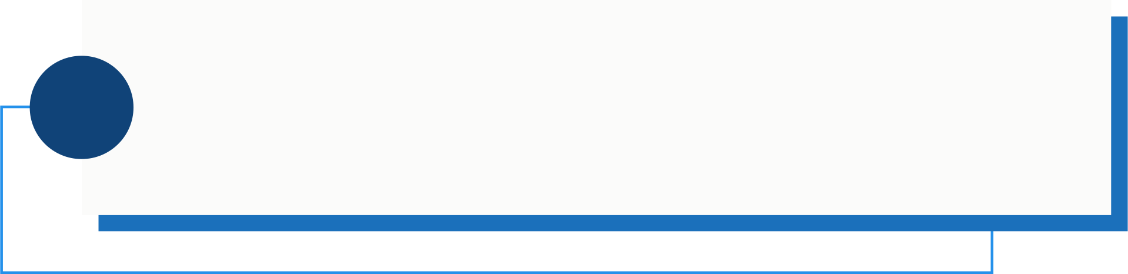
OBJECTIVES
Dataset Expansion and Diversity
Automated SOAP Note Generation
1
To improve dataset diversity using translation pipelines and
LLaMA-generated synthetic conversations.
2
To architect an NLP engine that synthesizes the transcribed
data into SOAP note in the supported language.
Handling 'Code-Switching'
Cross-Lingual Translation & Mapping
3
To handle code-mixed medical conversations where speakers switch between languages.
4
To develop a pipeline that converts Indic language complaints into standardized medical form.
Clinical Entity Recognition
Multilingual Speech Recognition (ASR)
5
To extract key medical entities such as symptoms, emotions, duration, and severity from conversational data.
6
To develop a multilingual ASR system capable of transcribing English and Indic languages with high accuracy.
Multi-Speaker Diarization
Validation Framework
7
To use speaker diarization to differentiate between doctor and patient dialogue for accurate SOAP section classification.
8
To evaluate generated SOAP notes for clinical relevance, accuracy and structural completeness.

Slide 4
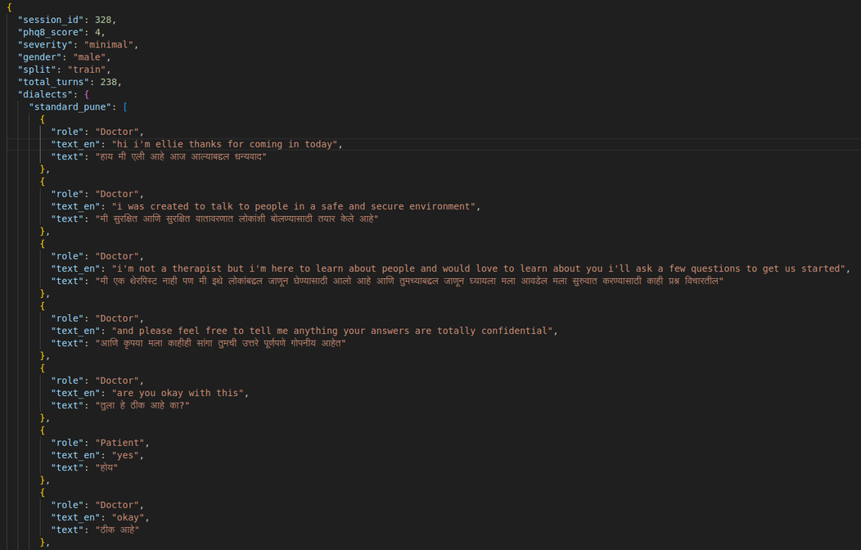
DATASET DESCRIPTION
DATASET
SOURCE
The dataset is derived from the DAIC-WOZ mental health interview corpus, which contains therapist–patient conversations.
OVERVIEW
DATA
PROCESSING
Parsed DAIC-WOZ transcripts to obtain conversation turns, speaker roles, and session metadata such as PHQ-8 score, severity, and gender and adapted the conversations into multiple Marathi dialect styles.
English conversations were translated into Marathi using a custom translation pipeline. The dataset was further expanded using the LLaMA model to generate additional synthetic conversations while preserving clinical context and PHQ-8 labels.
TRANSLATION &
EXPANSION

Slide 5
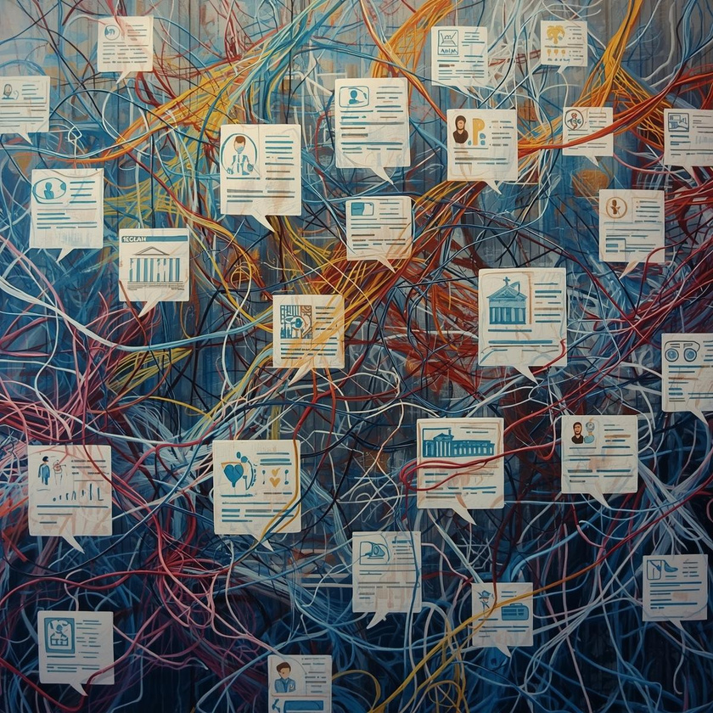
CHALLENGES
Dataset Language Limitation
Entity Extraction in Marathi
The DAIC-WOZ dataset is originally in English, while our system focuses on Marathi conversational data, requiring additional translation and preprocessing.
Most existing NER models are designed for English, so identifying medical entities in Marathi conversations required additional rule-based patterns.
Maintaining Clinical Context During Translation
Dataset Expansion
Synthetic conversations generated using LLaMA sometimes produced hallucinated or clinically inconsistent information, requiring additional validation to maintain dataset quality.
Direct translation sometimes produced incorrect or unnatural medical terminology, making it difficult to preserve the clinical meaning of conversations.
Dialect Variations in Marathi
Generating Clinically Accurate SOAP Notes
Marathi has several dialects such as Pune, Konkan, Vidarbha, and Marathwada, which introduce variation in vocabulary and sentence structure.
Ensuring that generated SOAP notes were structured, concise, and medically relevant required careful prompt design and validation.

Slide 6
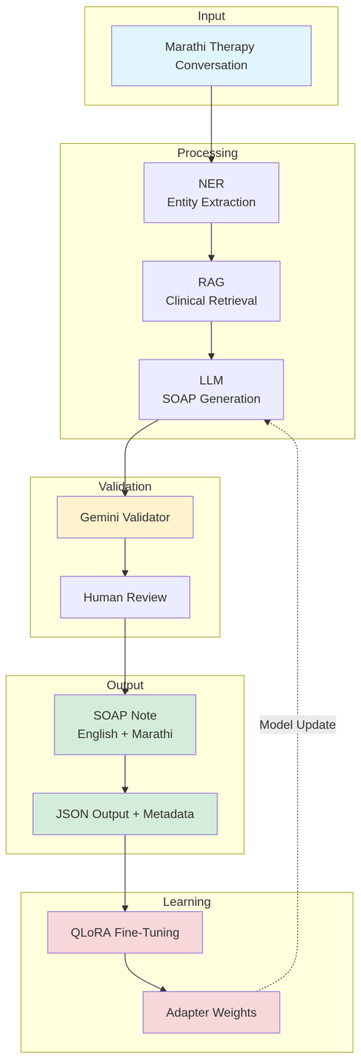
SYSTEM ARCHITECTURE
The proposed framework converts unstructured Marathi medical conversations into structured SOAP notes using a modular NLP pipeline. It combines entity extraction, contextual retrieval, language modeling, validation, and model learning to generate clinically meaningful documentation.

Slide 7
NAMED ENTITY RECOGNITION
The NER module extracts clinically relevant information from therapy conversations. A hybrid approach combining pretrained biomedical NER models, IndicNER model and rule-based keyword matching is used to identify mental health related entities from Marathi and English conversational text.
NER aims to :
Extract medical entities from conversational therapy transcripts
Use BioBERT / IndicNER models for biomedical entity recognition
Apply rule-based keyword matching for mental health terminology
Handle code-mixed Marathi–English conversations
Provide structured entities used by the RAG and LLM modules

Slide 8
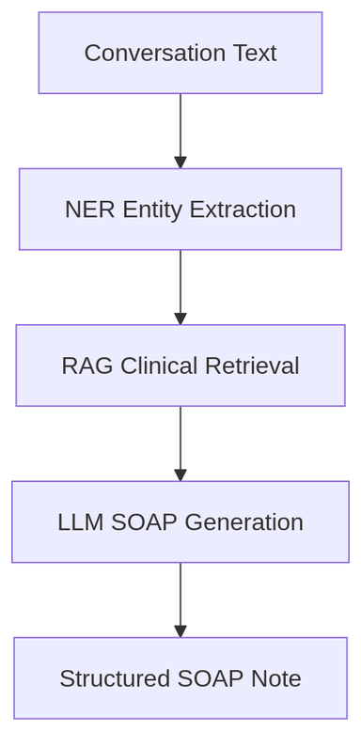
SOAP NOTE GENERATION
The system uses a Retrieval-Augmented Generation (RAG) framework combined with a Large Language Model to generate clinically accurate SOAP notes. Clinical knowledge retrieved from a vector database is provided as contextual information to the LLM, improving the accuracy and reliability of generated medical documentation.
Key Functions :
RAG retrieves relevant clinical terminology from a vector database
Uses ChromaDB vector similarity search to find related medical concepts
Retrieved clinical context is passed to the LLM
The LLM generates structured SOAP notes based on conversation data and retrieved knowledge
Improves medical accuracy and contextual understanding

Slide 9
QLORA FINE TUNING
LoRA Adapter Layers
Prompt-Response Training
Instead of modifying all model parameters, low-rank adapter matrices are inserted into attention layers (q_proj, k_proj, v_proj, o_proj) to learn task-specific behavior.
Training data is formatted as prompt + response pairs, where therapy conversation inputs are mapped to structured SOAP note outputs.
Parameter Efficient Learning
4-bit Quantization
Only the LoRA adapter weights are updated during training, while the base model weights remain frozen.
The base LLM is loaded using 4-bit precision, significantly reducing memory usage and enabling efficient training on standard GPUs.

Slide 10
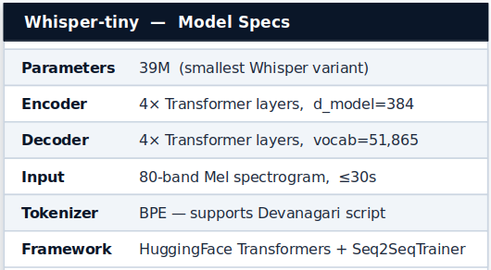
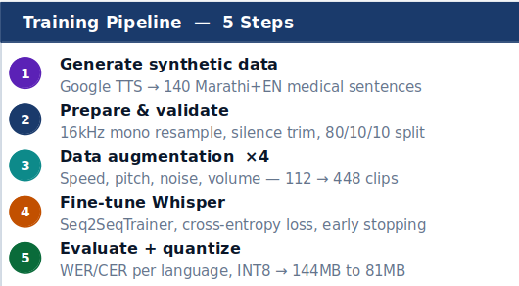
ARCHITECTURE AND TRAINING PIPELINE
39M
448
20%
V4
Parameters
(Whisper-tiny)
Training clips
(aug. from 112)
English WER
(medical test set)
Inference version
(halluc. suppressed)
↓ Hallucination Filter + Text Cleaning → Timestamped Speaker-Labelled Transcript

Slide 11
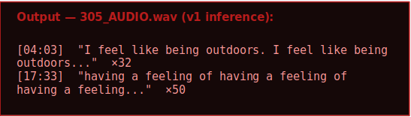
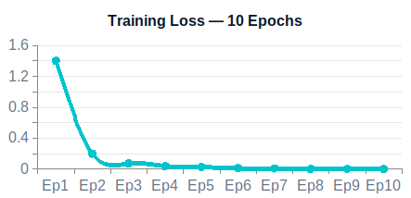
TRAINING RESULTS & HALLUCINATION CONTROL
⚠ What is Whisper Hallucination?
On silent/noisy chunks, Whisper generates plausible-sounding text instead of nothing — looping high-probability phrases indefinitely. A known failure mode of all autoregressive models.
3-Layer Fix (v4)
① VAD
Skip chunks where <10% of 20ms frames have speech energy — silent segments never reach Whisper
② Generation penalties
no_repeat_ngram_size = 3 blocks 3-word loops repetition_penalty = 1.2 penalises repeated tokens
③ Post-filter
Unique word ratio <25% → discard · Known hallucination phrase blacklist · Sentence deduplication

Slide 12
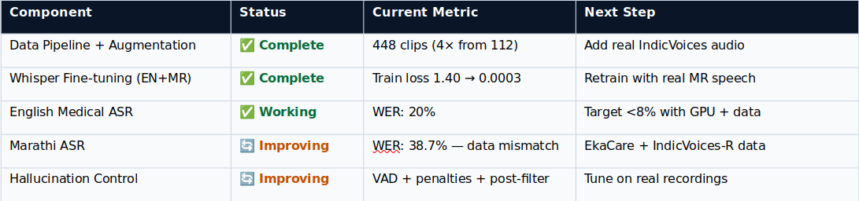
Root Cause — High Marathi WER
Key Technical Contributions
Training used gTTS synthetic voice — robotic, flat, no background noise. Real doctor-patient speech has natural intonation, fast speech and overlapping voices. The model learned the right words but the wrong acoustic patterns.
Fix: EkaCare clinical conversations + AI4Bharat IndicVoices-R (1,704 hrs, 10,496 real speakers).
Expected WER after retrain: <25% Marathi, <8% English.
Multilingual fine-tuning
Data augmentation pipeline
First Whisper fine-tune for MR-EN code-switched medical speech
8 transforms, 4× dataset multiplication, no extra recordings
Custom VAD
Hallucination suppression
RMS + 20ms frame analysis, no external library, no ffmpeg
3-layer: generation penalties + unique ratio + phrase blacklist
Production inference
Full evaluation framework
28-min audio tested, speaker hints, .txt+.json output
WER/CER per language, examples.csv for targeted improvement

Slide 13
REFERENCES
1.PHQ-8 DEPRESSION QUESTIONNAIRE
4.AI4BHARAT – INDIC NLP RESOURCES
Patient Health Questionnaire-8 (PHQ-8) is a validated tool used to measure depressive symptoms and severity in clinical studies.
https://selfmanagementresource.com/wpcontent/uploads/English_-_PHQ-8-1.pdf
AI4Bharat is an open research initiative from IIT Madras focused on developing open-source datasets, models and tools for Indian languages. It provides multilingual NLP resources such as IndicNER and translation models supporting multiple Indic languages.
https://ai4bharat.iitm.ac.in/
2.DAIC-WOZ DATASET
5. EMOINHINDI
Distress Analysis Interview Corpus – Wizard of Oz dataset used for depression analysis from clinical interviews.
https://dcapswoz.ict.usc.edu/wwwdaicwoz/
Singh, G.V., Priya, P., Firdaus, M., Ekbal, A., & Bhattacharyya, P. (2022)
EmoInHindi: A Multi-label Emotion and Intensity Annotated Dataset in Hindi for Emotion Recognition in Dialogues.
https://github.com/TusharD-047/EmoInHindi
3.AUTOMATIC SOAP NOTE GENERATION – COEP TECHNOLOGICAL UNIVERSITY

Slide 14
CONCLUSION
This project presents a modular NLP pipeline for automated SOAP note generation from Marathi therapy conversations. By combining speech processing, entity extraction, contextual retrieval, and large language models, the system transforms unstructured conversational data into structured clinical documentation.
The proposed architecture integrates Named Entity Recognition (NER), Retrieval-Augmented Generation (RAG), and Large Language Models (LLMs) to accurately identify medical entities, retrieve relevant clinical terminology, and generate structured SOAP notes. The system further incorporates validation mechanisms and QLoRA-based fine-tuning to improve model reliability and adaptability.
Experimental results demonstrate that the pipeline can effectively capture clinical information from conversational text and convert it into standardized medical documentation, supporting automated healthcare record generation.
Overall, the proposed framework contributes toward AI-assisted clinical documentation for Indic languages, helping reduce manual workload for healthcare professionals while improving accessibility of medical NLP systems for regional languages.
Management
Management

Slide 15
THANK YOU VERY MUCH!

